Slide 1
Campsite Sales Analysis.
Using Tableau to conduct a thorough sales analysis of a campsite tuck shop.

Slide 2
Objectives
To perform a thorough data analysis of the campsite’s tuckshop.
To determine whether there are any factors which may be affecting the campsites sales.
To make recommendations on how the campsite can increase sales.

Slide 3
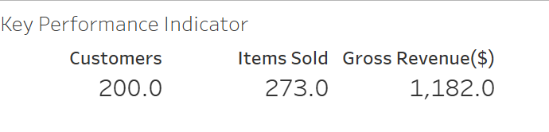
Sales Insights
Before anything else I needed to determine the key performance indicators what the company sold It’s revenue and the amount of foot traffic or customers it had.
Using tableau I was able to create a visual showing these key performance indicators allowing me to gauge what the company was already bringing in before I recommended any changes.

Slide 4
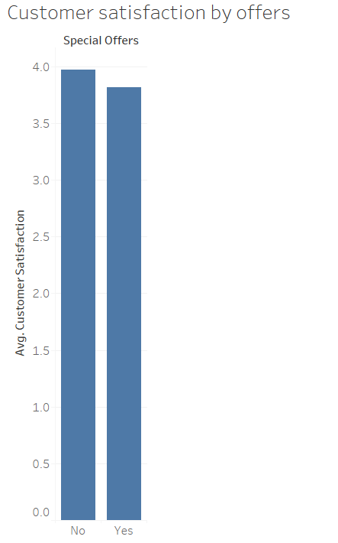
Customer Insights
Here I’ve used a bar chart to determine whether the presence of special offers made any difference to customer satisfaction levels.
From the chart we can determine that the special offers had little affect on customer satisfaction meaning the financial cost is not yielding the expected results.

Slide 5
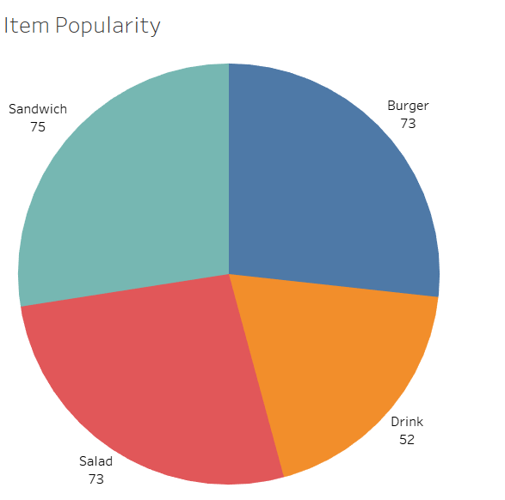
Product Breakdown
Pictured is a pie chart of the various items that the campsite sells and the frequency of their sales.
We are able to infer that sandwiches are the most popular item the campsite sells and that they should be stocked the most to ensure the most popular item is always available.

Slide 6
External Factors
Pictured here is a tree map showing the average sales by each whether type as we can see the demand is highest when the weather is sunny and falls off significantly during the rainy or cloudy weather.
This can influence the stocking of items during bad whether as people are less likely to travel to the shop allowing the shop to only stock what is necessary and avoid waste.

Slide 7
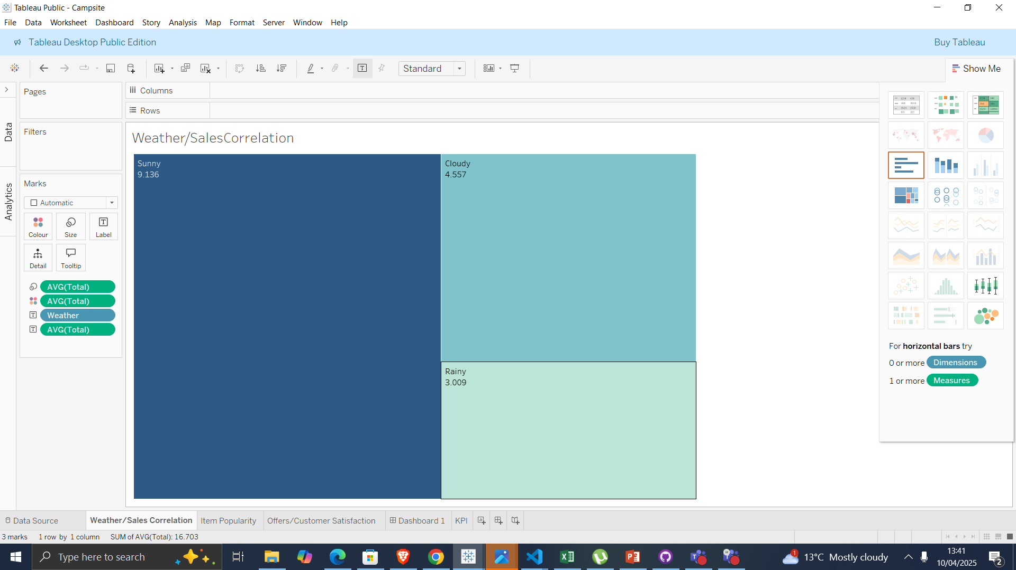

Slide 8
Recommendations
Some recommendations I would make to the campsite store would be to:
Remove the special offers as they cost the campsite money and do not yield any results if determined to keep improve them.
Try and increase foot traffic the low margins for the items means that the shop needs more customers to generate more revenue.
Stock less items when the weather is poorly people do not travel to the shop as much and any unsold inventory is wasted.

Slide 9
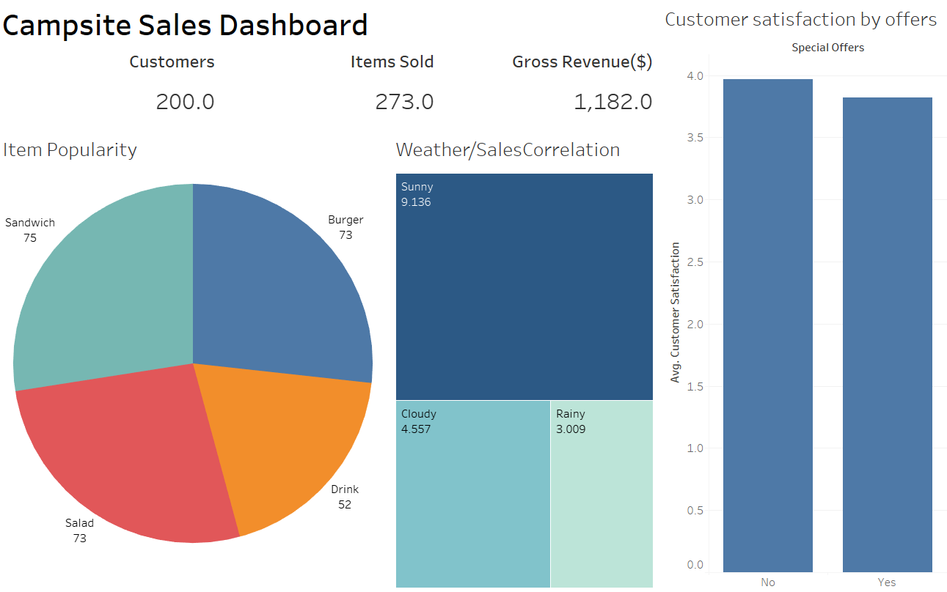
Final Dashboard

